Slide 1

Surface Ozone Pollution in the Northern Colorado Front Range
Dan Welsh, Katie Broyles, Scott Landes
Colorado Department of Public Health and Environment
dan.welsh@state.co.us
Notes:
3 min

Slide 2
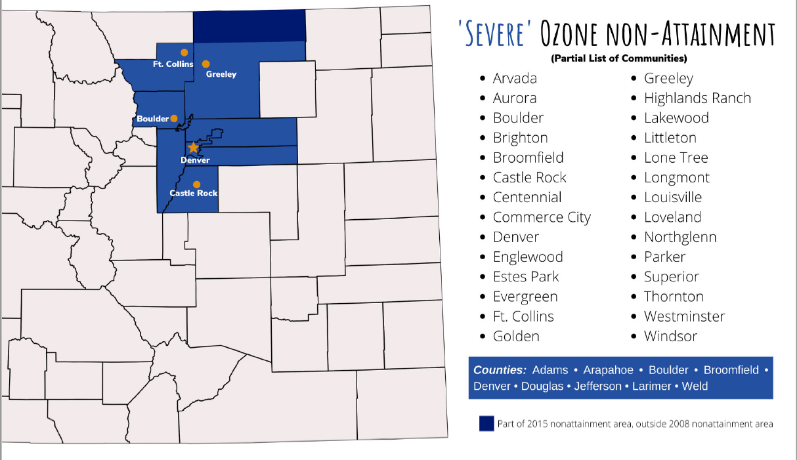
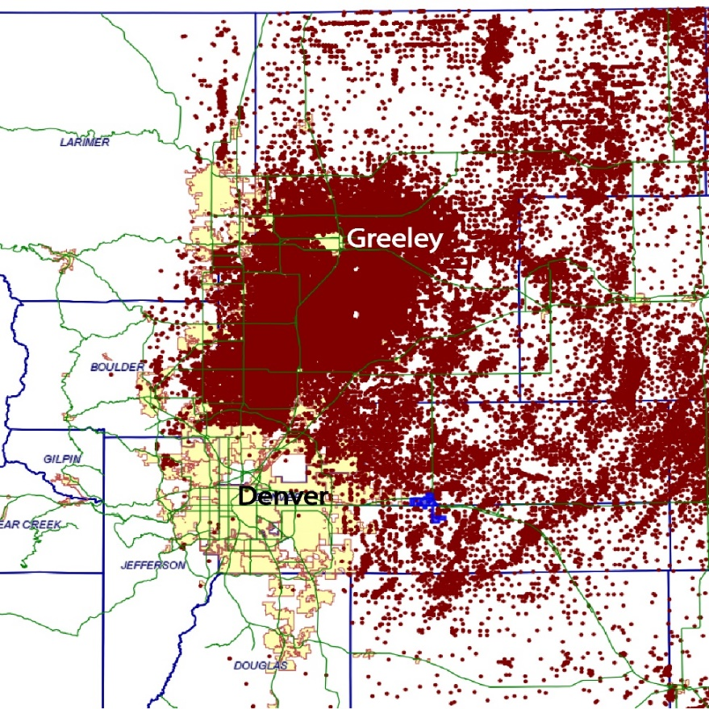

Background
Ozone Nonattainment area
-Repeated downgrade
-> Marginal (2008)
-> Moderate (2016)
-> Serious (2020)
-> Severe (2022)
Contributions:
Urban concentrations, traffic emissions
O&G Operations
Topography

Slide 3
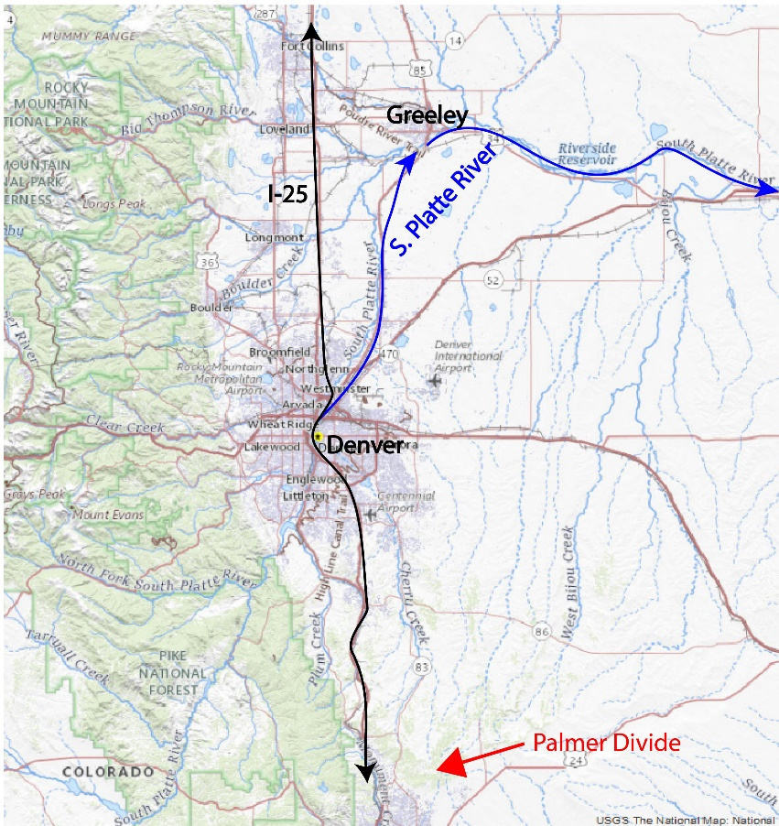
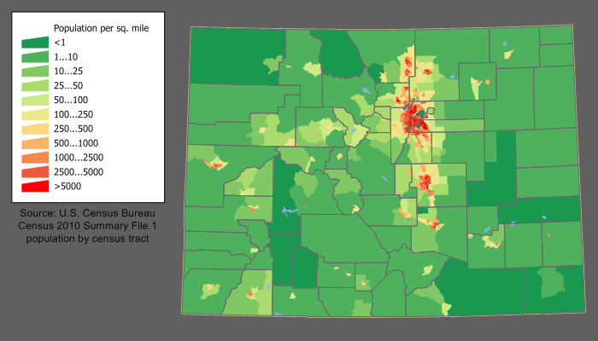
Background
Population Density highest along Colorado Front Range
Topography of region is also a major influence
Source: https://commons.wikimedia.org/wiki/File:Colorado_population_map.png

Slide 4
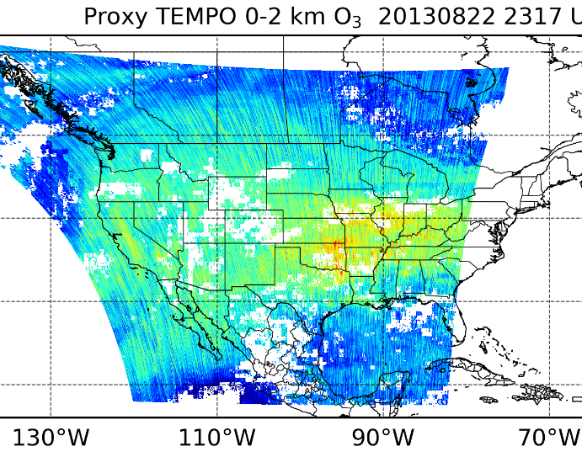

Green Paper Experiment Proposal
With due consideration of local meteorological factors in mind, CDPHE air quality forecasters are able to predict potentially unhealthy conditions due to ozone with reliable accuracy.
However, further documentation of these processes will lead to greater understanding of the timing, spatial extent, and severity of air pollution episodes when they occur.
Use of TEMPO special operations can be employed to observe trace gasses and ozone precursors, and follow the evolution as they convert to ozone and accumulate along the Colorado Front Range.

